Slide 1
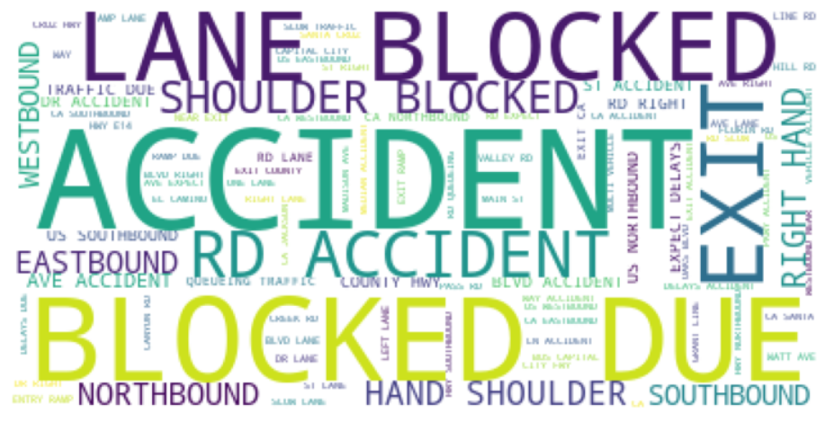

Slide 2

DS250-Data Analytics and visualization
Accident Severity Predictor
Ishaan Shrivastava
Rajat Bansal
Sajal Saini
Rohit Raj
Amber Singh

Slide 3
Motivation/Objective
US accident data from 50 states i.e. 3.5 million rows,
predicting severity,
interesting stories using data visualization techniques,

Slide 4
Data Collection and Cleaning
We took the dataset from Kaggle.
We dropped columns like Country, Civil_ Twilight, Nautical_Twilight, etc because of redundancy and they were of no use in modeling.
After plotting the graphs we also dropped City, County, State, Wind Chill etc as they were of no use in our model and we already had lat and lng of accident which could give us City, County, State.
We replaced NaN of precipitation with 0 because a large portion of dataset contains NaN in Precipitation, so we couldn’t just drop them.
Wind speed also had lot of NaN values so we replaced them with mean of wind speed.

Slide 5
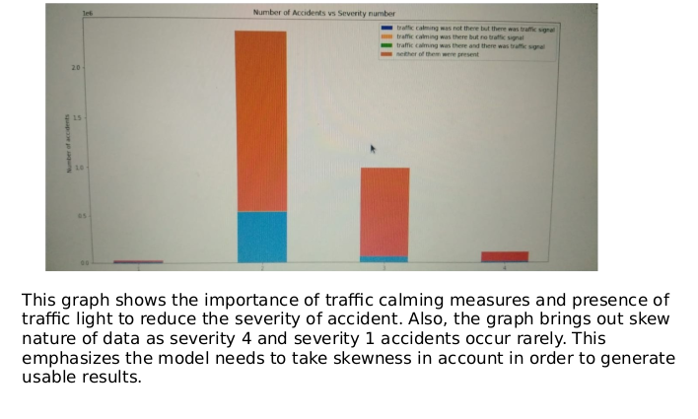
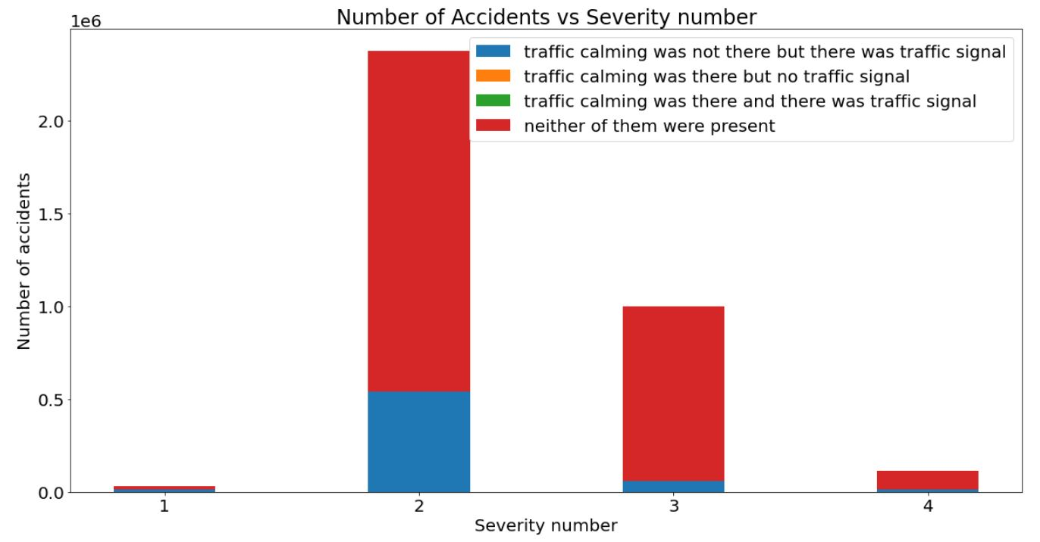
EDA

Slide 6
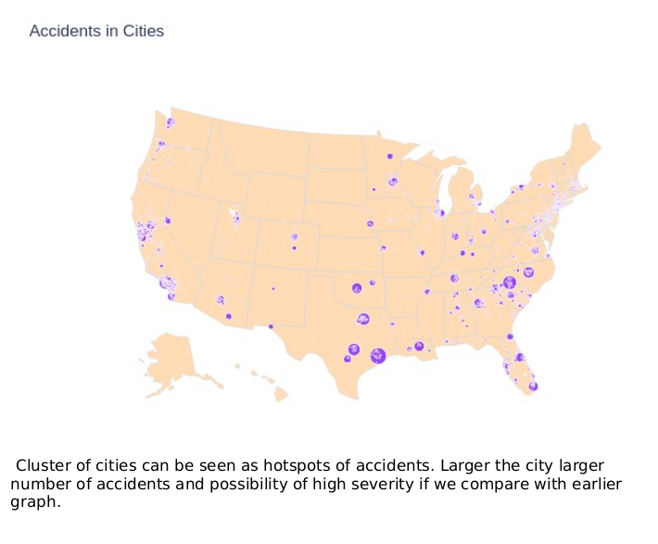
EDA

Slide 7
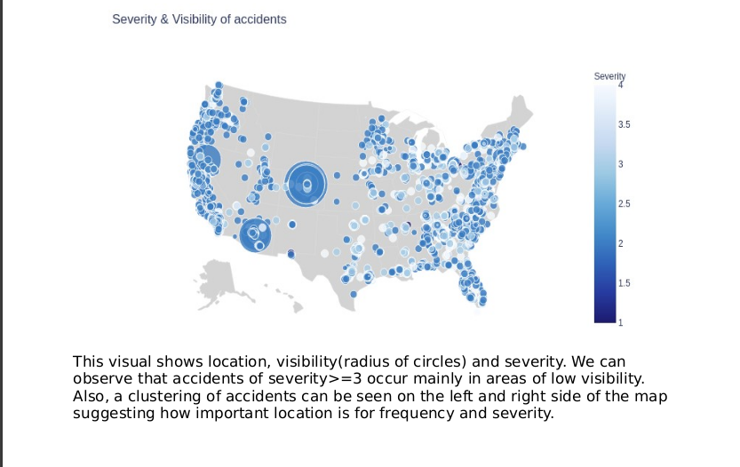
EDA

Slide 8
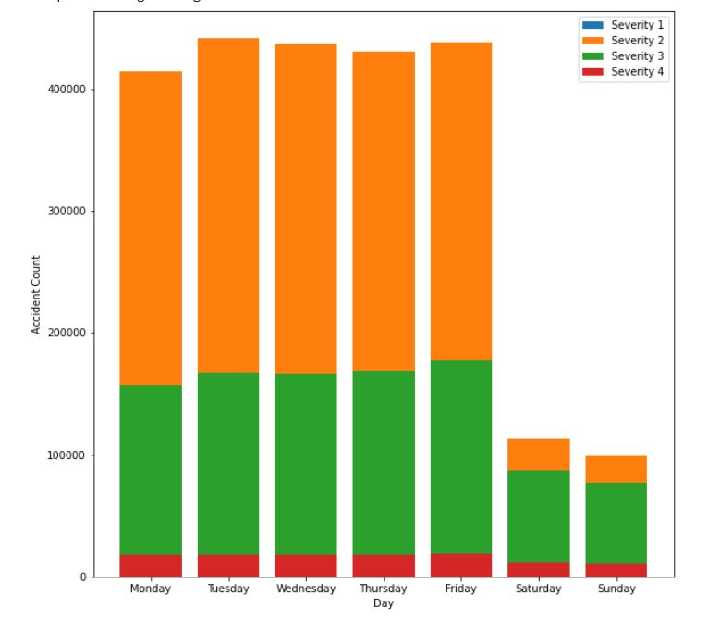
EDA

Slide 9
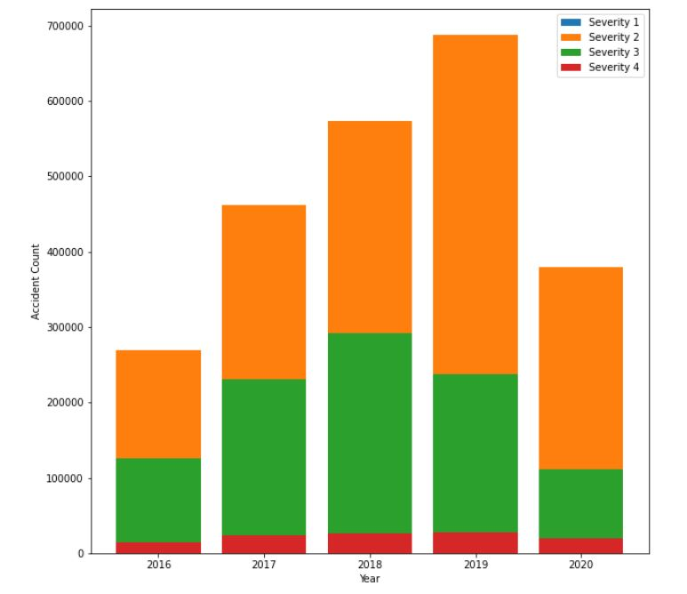
EDA
Data collected by the APIs suggest that there is a significant drop in the proportion of severity 3 in comparison to severity 2 which is a good indication.
Severity 4 are a rarity which is a fair sign.

Slide 10
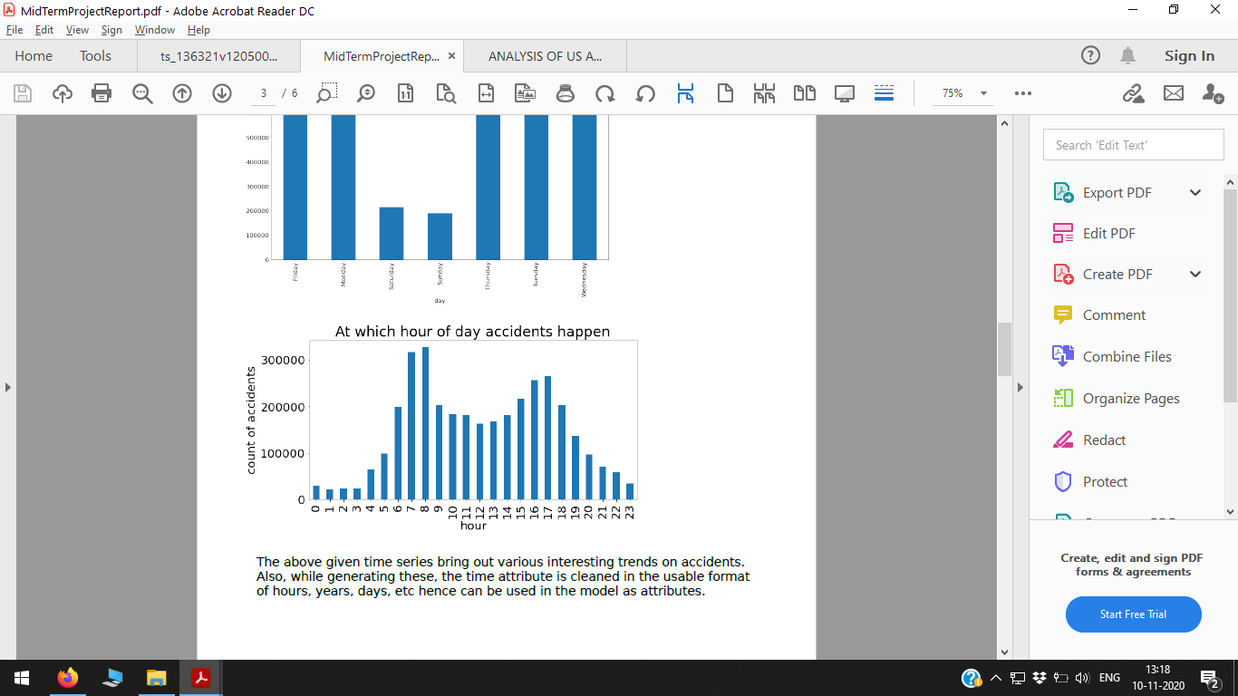
EDA

Slide 11
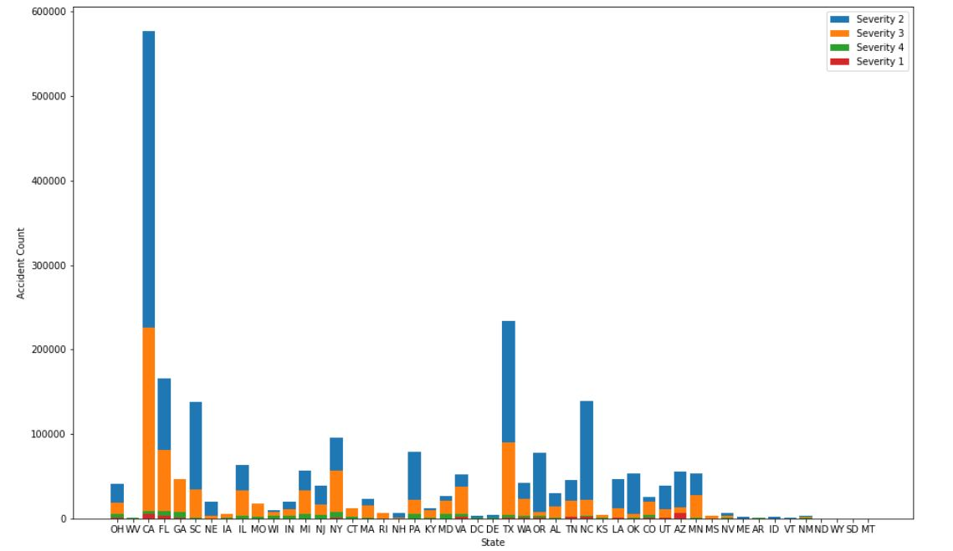
EDA

Slide 12
Models
I.) Benchmarking
Before arriving on a model it is very important to know what accuracy are we aiming to achieve.
For this we used skews in the existing dataset.
Occurrence percentage of severity 2 in dataset: 67%

Slide 13
Models
II.) Modelling Summary
Since our problem is a classification problem, we decided to start with one of the most basic and least complex problem of decision tree and the results have been phenomenal (~80% accuracy).
We also decided to use a variant of Decision Tree, namely, the Random Forest to see if we can get better accuracy.
In addition we also tried batch learning versions of SVM Classifiers and Logistic Regression (via SGD), the results of these were disastrous. Since they also took longer time in comparison to Decision Trees and Forests, we were not able to fine tune the results.
We also tried kNN with k as root of total records but the RAM blew up while training.

Slide 14
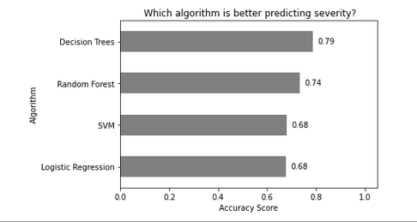
Models
II.) Modelling Summary
Initially we were having plans for implementing Neural Networks but the size of data set was creating the problem of long duration of training rendering us not able to change parameters and

Slide 15
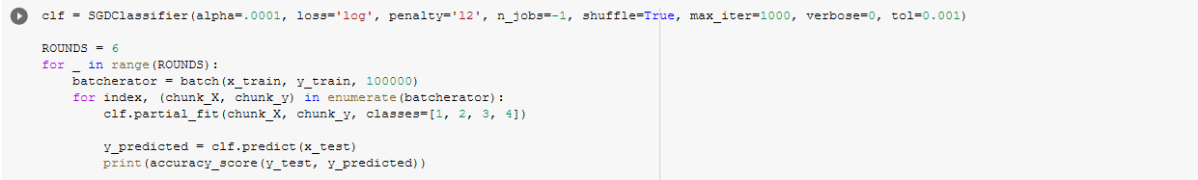
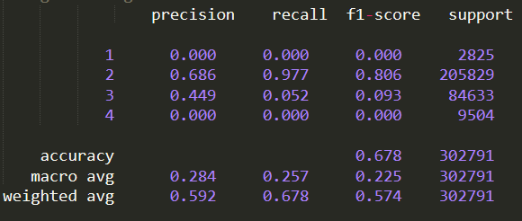
Models
II.) SGD Classifier: Logistic Regression
Batch Size:100,000
Very bad model with accuracy very similar to benchmark
As observed from Precision and Recall, the model is not able to classify sev 1 and sev 4 at all.
Even the classification between 2 and 3, recall of sev 3 is ridiculously low.
This was tested on various batch sizes but the results were similar.

Slide 16
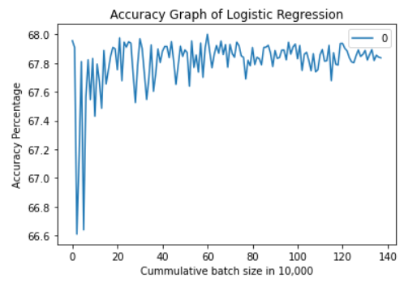
Models
II.) SGD Classifier: Logistic Regression

Slide 17
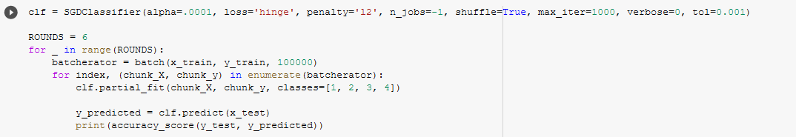
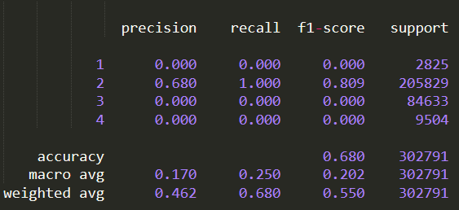
Models
II.) SGD Classifier: SVM
Batch Size:100,000
Worst model with accuracy equal to benchmark.
As observed from Precision and Recall, the model is not able to classify sev 1, sev 2 and sev 4 at all.
The model goes on to predict sev 2 blindly irrespective of any condition. (the way we generated benchmarks)
This was tested on various batch sizes but the results were similar.

Slide 18
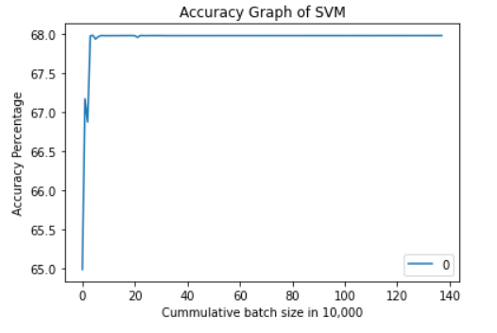
Models
II.) SGD Classifier: SVM
Batch Size:100,000

Slide 19
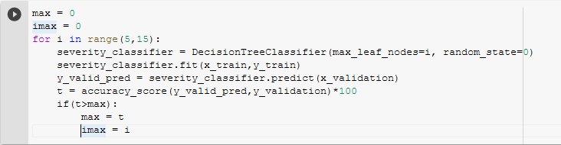
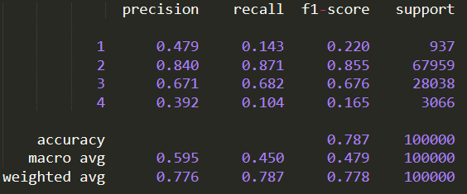
Models
II.) Decision Tree
Best model with accuracy equal of around 79% (way above the benchmark)
As observed from Precision and Recall it is fairly able to classify between sev 2 and sev 3.
Precision of sev 1 and sev 4 is also appreciable despite them occurring very rarely.
Recall of sev 1 and sev 4 is low which is an expected trait due to the skewness of data

Slide 20
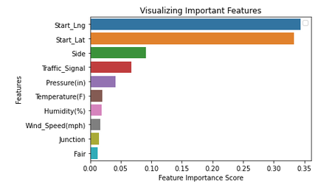
Models
II.) Decision Tree

Slide 21
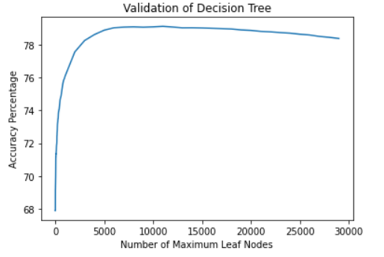
Models
II.) Decision Tree

Slide 22
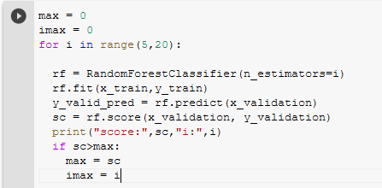
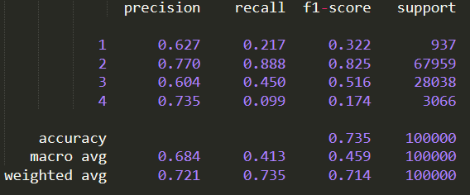
Models
II.) Random Forest
Fairly good model with accuracy equal of around 73% (way above the benchmark)
As observed from Precision and Recall it is fairly able to classify between sev 2 and sev 3. Precision for sev 1 and sev 4 is even higher than Decision tree. Although recall of sev 4 is abysmal.
Higher accuracy and better model can be expected if we increase number of decision trees. We couldn’t do this as our RAM usage crossed the quota.

Slide 23
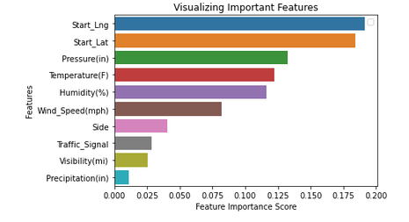
Models
II.) Random Forest

Slide 24
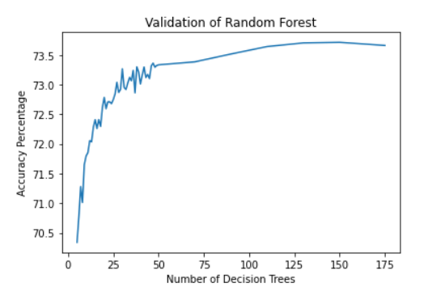
Models
II.) Random Forest

Slide 25
Models
III.) Training Methodology
Division of Dataset: 75% Training + 15% Validation +10% Testing
Values for Validation in Decision Tree:
Since, Training Decision Tree and Random Forest require a significant amount of memory, we had to reduce our training data set to 1 million records (nearly half of what we wanted to use) due to memory requirements but even then the results were way better than other models.

Slide 26
Concluding Slide
Problems Faced and Solutions to be implemented (+General Notes).
Due to large size of data set, memory management is a problem.
Decision Tree and Random Forest Tree occupy significant space in memory while executing.
To counter the above problems, we implemented Incremental Learning Algorithms like SVM and Logistic Regression but their performances were abysmal. (and large training time)
We also ran the full sample on Logistic Regression but got an accuracy of around 70% which was way near the benchmark decided.
kNN failed to execute for general value of k (root n) due to RAM requirements. Also, for small values the training was too much time consuming.
Training time wise Decision tree was the best algorithm.
Link to Dataset: https://www.kaggle.com/sobhanmoosavi/us-accidents

